Slide 1
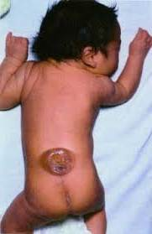
Periconceptional Antiretroviral Exposure and Central Nervous System and Neural Tube Defects – Data from the Antiretroviral Pregnancy Registry
Open spinal bifida (Copp & Greene, 2016,
Encyclopedia of Life Sciences,
John Wiley)
LM Mofenson, V Vannappagari, AE Scheuerle, B Baugh,
KP Beckerman, H Betman, N Chakhtoura, K Dominguez, A Pikis, NS Santanello, WR Short, CT Thorne, H Tilson, V Vinas, DH Watts, JD Albano on behalf of the APR Steering Committee
10th International AIDS Society Conference on HIV Science
Mexico City, July 23 2019

Slide 2
Disclosures
The APR is a collaborative project jointly funded by the following manufacturers:
The views are those of the authors and do not reflect the opinions of the
U.S. Department of State or the U.S. government
AbbVie
Accord Healthcare
Alvogen
Amneal Pharmaceuticals
Apotex Aurobindo Pharma Boehringer Ingelheim Pharmaceuticals Bristol-Myers Squibb Company
Celltrion Cipla
F. Hoffman La-Roche
Gilead Sciences Hetero Labs Hikma Pharmaeuticals USA
Janssen Scientific Affairs
Lannett Company
Lupin Pharmaceutical
Macleods Pharmaceuticals
Merck & Company
Mylan Laboratories
Novartis Pharmaceuticals
Prinston Pharmaceutical Qilu Pharmaceutical
Sandoz Inc.
SigmaPharm Laboratories
Strides Shasun Teva Pharmaceuticals
ViiV Healthcare

Slide 3
Introduction
In May 2018, a potential signal of an increase in neural tube defects (NTD) with periconception dolutegravir (DTG) exposure was reported from the Tsepamo birth surveillance study in Botswana.
There are limited data on birth defect outcome with periconception exposure outside the Tsepamo Study.
We evaluated the prevalence of central nervous system (CNS) defects, NTDs and encephalocele in the Antiretroviral Pregnancy Registry by drug class and individual drugs. Encephalocele is considered separately from NTD in the APR as it may occur slightly after neural tube closure. Data are updated through January 31 2019 (and differ from abstract).

Slide 4
Birth Defect Surveillance: Antiretroviral Pregnancy Registry
Since 1989, the Antiretroviral Pregnancy Registry has collected prospective, voluntary, anonymized reports of women on ART during pregnancy, capturing data after birth on birth outcomes.
Provides an estimate of risk for major birth defects compared to general population, to give an early warning of potential teratogenicity.
Currently international registry including 160 antiretroviral drugs – 57 brand, 103 generic drugs.

Slide 5
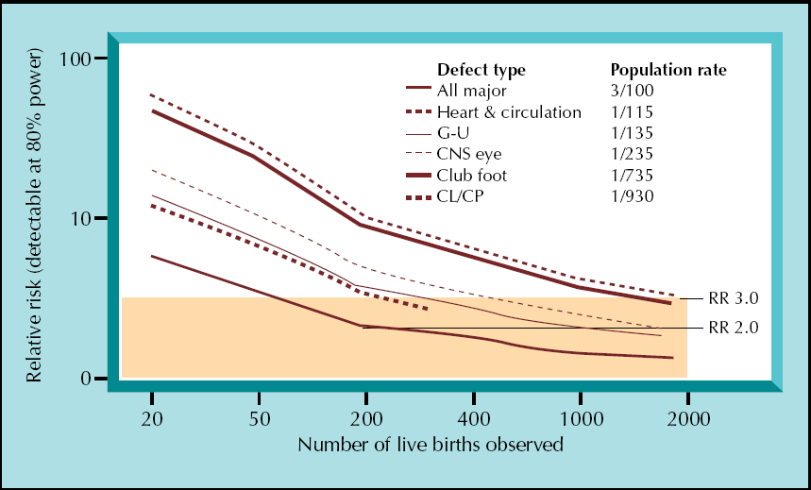
Ability to Rule-Out An Increase in Birth Defects With Drug Exposure is Related to Defect Prevalence and Number of Observed Exposures
200 exposures can rule out a 2-fold ↑ in overall birth defects (prevalence 3%)
Watts DH.
Curr HIV/AIDS Rep
2007;4:135-140
Overall defect
prevalence 3%
RR 2.0

Slide 6
Ability to Rule-Out An Increase in Birth Defects With Drug Exposure is Related to Defect Prevalence and Number of Observed Exposures
However, to rule-out a 3-fold increase in a rare event like NTD (prevalence 0.1%), need ~ 2,000 preconception exposures
Neural tube defect
prevalence 0.1%
Watts DH.
Curr HIV/AIDS Rep
2007;4:135-140
RR 3.0
Overall defects
prevalence 3%
RR 2.0

Slide 7
Components of the APR and Primary Analysis
Prospective
Retrospective
Clinical Studies
Reported during pregnancy before
delivery, follow-up for outcome
Timing, Dosage, Type of Antiretroviral Drug Use,
Concomitant Exposures, and
Pregnancy Outcome/Birth Defect at Time of Delivery
Reported after birth,
no denominator
APR Primary Analysis
number of defects^
number of live births
Compared to:
MACDP* 3/100 live births
TBDR* 4/100 live births
1st trimester vs. 2nd & 3rd trimester
Prevalence =
Secondary Analyses
Secondary Review for
Clusters and Patterns
^ defects counted among all outcomes >20 wks gestation including stillbirth, induced abortion & live births
* MACDP = Metropolitan Atlanta Congenital Defects Program; TBDR = Texas Birth Defects Registry

Slide 8
Methods
Primary Analysis (Prospective)
Clinicians register pregnant women with prenatal ARV exposures before pregnancy outcome is known, report data on exposure throughout pregnancy, and provide birth outcome data.
Birth defects are reviewed by a dysmorphologist, coded according to modified Metropolitan Atlanta Congenital Defects Program (MACDP) criteria, and classified by organ system.
Analysis includes birth defects, defined as ≥1 major birth defect or ≥2 minor defects.

Slide 9
Methods
Data on prospectively enrolled pregnancies through January 2019 with birth outcome are summarized:
Overall, by drug class and by specific drug
Earliest timing of exposure was assigned to each drug:
Periconception – ARV exposure from 2 weeks before conception through ≤28 days after conception (6 weeks estimated gestational age)
Later 1st trimester – Initial exposure started later in the 1st trimester (after 6 weeks estimated gestational age)
2nd/3rd trimester – Exposure started after the 1st trimester ended (> 12 weeks estimated gestational age)

Slide 10
Results – Primary Analysis
Maternal Demographic & Clinical Characteristics of Pregnant Women, Primary Prospective Enrollments and Outcomes Through January 31 2019
Total pregnancies (N) 1st Trimester 2nd Trimester 3rd Trimester | 20,372 (20,727 pregnancy outcomes) 10,952 (54%) (8,546 [78%] periconception) 7,018 (34%) 2,400 (12%)
Maternal age at conception (years) Median Range (min-max) | 29.0 13-55
CD4 T-cell count at time report N (%) ≥500 cells/µL 200-499 cells/µL <200 cells/µL | 31.4% 39.1% 13.9%

Slide 11
Drug-Specific Overall Birth Defect Rates*
Prevalence of Birth Defects (95% CI) with 1st Trimester Exposure: 1 January 1989 – 31 January 2019
*For drug to be included for comparison with population rates, must meet threshold of having ≥200 1st trimester exposed pregnancies
Metropolitan Atlanta
Congenital Defects
Program
(2.76%)
Texas Birth
Defects Registry
(4.19%)
No drug has 95% CI that significantly
exceed population comparisons with exception of nelfinavir and ddI, which exceed MACDP but not TBDR and have no specific defect pattern
21 ARVs have
≥200 exposures
2.75% (CI 2.4-3.0%)

Slide 12
CNS and NTD in the Prospective APR by Drug Class and Selected ARVs
Most reports come from US/Canada (75%); others include Europe (8%), Africa (7%), S America (6%) and Asia (4%).
In 20,727 pregnancy outcomes including 19,287 live births, there were 536 birth defect cases (2.8%), 51 CNS, including eight NTD (0.04%) and one encephalocele.
Of the 8,546 with periconception exposure there were 241 birth defect cases (2.8%) and 23 CNS defects, including three NTD.

Slide 13
Prospective APR, Periconception: CNS and NTD by Drug Class
Periconception ARV | Live Births | Any Defect | CNS Defects | Neural Tube Defect | Encephalocele
Any ART | 8546 | 241 | 23 | 3 (0.03%) | 0

Slide 14
Prospective APR, Periconception: CNS and NTD by Drug Class
Periconception ARV | Births | Any Defect | CNS Defects | Neural Tube Defect | Encephalocele
Any ART | 8546 | 241 | 23 | 3 (0.03%) | 0
Any NRTI/NtRTI ABC FTC 3TC TDF | 8013 1027 2742 4129 3366 | 230 32 68 129 80 | 22 4 8 13 8 | 3 (0.04%) 1 (0.10%) 2 (0.07%) 1 (0.02%) 2 (0.06%) | 0 0 0 0 0

Slide 15
Prospective APR, Periconception: CNS and NTD by Drug Class
Periconception ARV | Births | Any Defect | CNS Defects | Neural Tube Defect | Encephalocele
Any ART | 8546 | 241 | 23 | 3 (0.03%) | 0
Any NRTI/NtRTI ABC FTC 3TC TDF | 8013 1027 2742 4129 3366 | 230 32 68 129 80 | 22 4 8 13 8 | 3 (0.04%) 1 (0.10%) 2 (0.07%) 1 (0.02%) 2 (0.06%) | 0 0 0 0 x
Any PI ATV DRV LPV/r | 3830 1067 436 949 | 112 25 16 22 | 9 3 1 5 | 1 (0.03%) 1 (0.09%) 0 0 | 0 0 0 0

Slide 16
Prospective APR, Periconception: CNS and NTD by Drug Class
Periconception ARV | Births | Any Defect | CNS Deects | Neural Tube Defect | Encephalocele
Any ART | 8546 | 241 | 23 | 3 (0.03%) | 0
Any NRTI/NtRTI ABC FTC 3TC TDF | 8013 1027 2742 4129 3366 | 230 32 68 129 80 | 22 4 8 13 8 | 3 (0.04%) 1 (0.10%) 2 (0.07%) 1 (0.02%) 2 (0.06%) | 0 0 0 0 x
Any PI ATV DRV LPV/r | 3830 1067 436 949 | 112 25 16 22 | 9 3 1 5 | 1 (0.03%) 1 (0.09%) 0 0 | 0 0 0 0
Any NNRTI EFV NVP RPV | 2304 1037 943 329 | 57 25 28 4 | 5 3 2 0 | 1 (0.04%) 1 (0.10%) 0 0 | 0 0 0 0

Slide 17
Periconception ARV | Births | Any Defect | CNS Defects | Neural Tube Defect | Encephalocele
Any ART | 8546 | 241 | 23 | 3 (0.03%) | 0
Any NRTI/NtRTI ABC FTC 3TC TDF | 8013 1027 2742 4129 3366 | 230 32 68 129 80 | 22 4 8 13 8 | 3 (0.04%) 1 (0.10%) 2 (0.07%) 1 (0.02%) 2 (0.06%) | 0 0 0 0 x
Any PI ATV DRV LPV/r | 3830 1067 436 949 | 112 25 16 22 | 9 3 1 5 | 1 (0.03%) 1 (0.09%) 0 0 | 0 0 0 0
Any NNRTI EFV NVP RPV | 2304 1037 943 329 | 57 25 28 4 | 5 3 2 0 | 1 (0.04%) 1 (0.10%) 0 0 | 0 0 0 0
InSTI DTG EVG RAL | 725 248 217 268 | 21 9 6 8 | 3 2 1 0 | 1 (0.14%) 1 (0.40%) 0 0 | 0 0 0 0

Slide 18
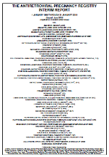
Prospective Antiretroviral Pregnancy Registry
Periconception ARV Neural Tube Defect (NTD) Cases
Details of Prospective NTD Case with Periconception Drug Exposure through January 2019
Defect | Anencephaly | Myelomeningocele | Meningocele
Drug exposure (timing) | Abacavir (P) Dolutegravir (P) Lamivudine (P) | Efavirenz (P) Emtricitabine (P) Tenofovir Disoproxil Fumarate (P) Lamivudine (T2) Nelfinavir (T2) Zidovudine (T2) | Atazanavir (P) Emtricitabine (P) Ritonavir (P) Tenofovir Disoproxil Fumarate (P) Zidovudine (T3)
Country of report | US | US | US
Outcome | Stillbirth | Livebirth | Livebirth
Confounding factors | Hispanic | Fetal alcohol syndrome | n/a
P = periconception, T2 = second trimester, T3 = third trimester; US = United States

Slide 19
Conclusions
The overall prevalence of NTD in 8,546 periconception ARV exposures was 0.03%.
Most of the reports in the APR come from North America, where there is national food folic acid fortification, which has been shown to reduce NTDs risk by 36%-68% in the general population (Wang Nutr 2016; Williams MMWR 2015; Ray Food Nutr Bull 2008)
Thus, this frequency is consistent with the observed low NTD prevalence (0.01%-0.08%) in most developed countries with food folic acid fortification.

Slide 20
Conclusions
In the updated APR data, there is one NTD with 248 periconception DTG exposures, giving a prevalence of 0.40% for DTG and 0.14% for InSTI class, but this is based on only one NTD in relatively small number of exposures.
The number of pregnancies enrolled in the APR with InSTI periconception exposure are currently insufficient to rule out or confirm any potential association with NTD.
Healthcare providers are encouraged to continue to report pregnancies with prospective antiretroviral exposures to the APR, especially those involving newer ARVs [www.APRegistry.com]

Slide 21
Conclusions
ADVISORY COMMITTEE CONSENSUS
In reviewing all reported defects from the prospective registry, informed by clinical studies and retrospective reports of antiretroviral exposure, the Registry finds no apparent increases in frequency of birth defects with first trimester exposures compared to exposures starting later in pregnancy and no pattern to suggest a common cause. While the Registry population exposed and monitored to date is not sufficient to detect an increase in the risk of relatively rare defects, these findings should provide some assurance when counseling patients. However, potential limitations of registries such as this should be recognized. The Registry is ongoing. Given the use of new therapies about which data are still insufficient, health care providers are strongly encouraged to report eligible patients to the Registry via the data forms available at www.APRegistry.com.
Notes:
The Antiretroviral Pregnancy Registry finds no apparent increases in frequency of defects with first trimester exposures compared to exposures starting later in pregnancy and no pattern to suggest a common cause; however, potential limitations of registries should be recognized. Providers are strongly encouraged to report eligible patients.

Slide 22
Key Contacts
Website: www.APRegistry.com
Email: SM_APR@APRegistry.com
The Antiretroviral Pregnancy Registry
301 Government Center Drive
Wilmington, NC 28403
US, Canada (toll-free): | (800) 258-4263 (Telephone)
 | (800) 800-1052 (Fax)
International: | +1-910-256-0637 (Fax)
UK, Germany, France (toll-free): | (00800) 5913-1359 (Telephone)
 | (00800) 5812-1658 (Fax)
EUROPE: | +32-2-714-5028 (Telephone)
 | +32-2-714-5024 (Fax)
BRAZIL (toll-free): | (0800) 892-1472 (Fax)

Slide 23
Acknowledgements
The authors acknowledge the outstanding efforts of all the clinicians submitting cases to the APR, as well as the valuable contributions of the APR Steering Committee and the Syneos Health, Coordinating Center Staff.
Independent Advisory Committee Members:
Cynthia Holcroft-Argani, MD, Johns Hopkins Medical Center;
Karen Beckerman, MD, Carl Icahn School of Medicine at Mt Sinai;
Nahida Chakhtoura, MD, National Institutes of Health;
Kenneth Dominguez, MD, MPH, Centers for Disease Control & Prevention;
Kathryn Arnold, MD, National Center on Birth Defects and Developmental Disabilities;
Lynne Mofenson, MD, Elizabeth Glaser Pediatric AIDS Foundation;
Andreas Pikis, MD, Food and Drug Administration;
Rosemary Ramroop, Johns Hopkins University;
Nancy Santanello, MD, MS, FISPE, Independent Pharmacoepidemiologist;
William Short, MD, MPH, AAHIVS, The University of Pennsylvania;
Claire Thorne, PhD, Institute of Child Health, University College London;
Heather Watts, MD, Office of the Global AIDS Coordinator & Health Diplomacy, U.S. Dept. of State

